Slide 1
Fundamentals of CRE
Chemical Reaction Engineering
By
Dr Salah N. Farhan
Senior lecturer. Chem. Eng. Dept.
College of Engineering
University of Diyala
Salah N. Farhan College of Engineering Diyala University

Slide 2
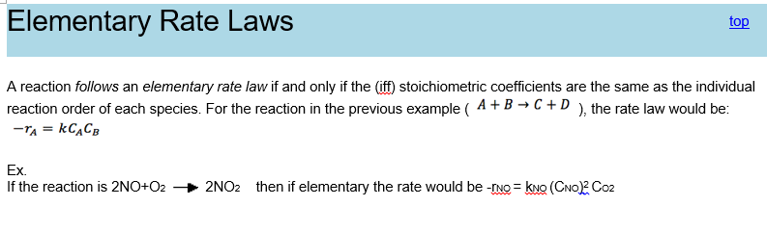
Fundamentals of CRE
Chapter 3: Rate Laws
Salah N. Farhan College of Engineering Diyala University

Slide 3
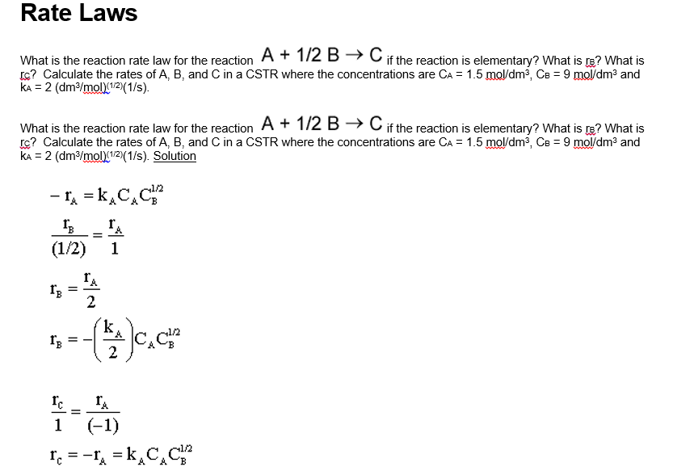
Fundamentals of CRE
Salah N. Farhan College of Engineering Diyala University

Slide 4
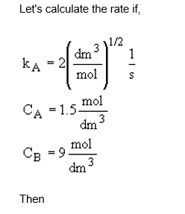
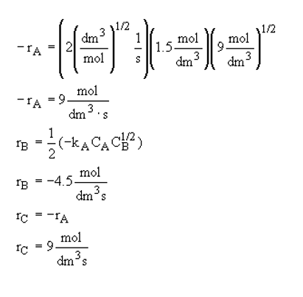
Fundamentals of CRE
Salah N. Farhan College of Engineering Diyala University

Slide 5
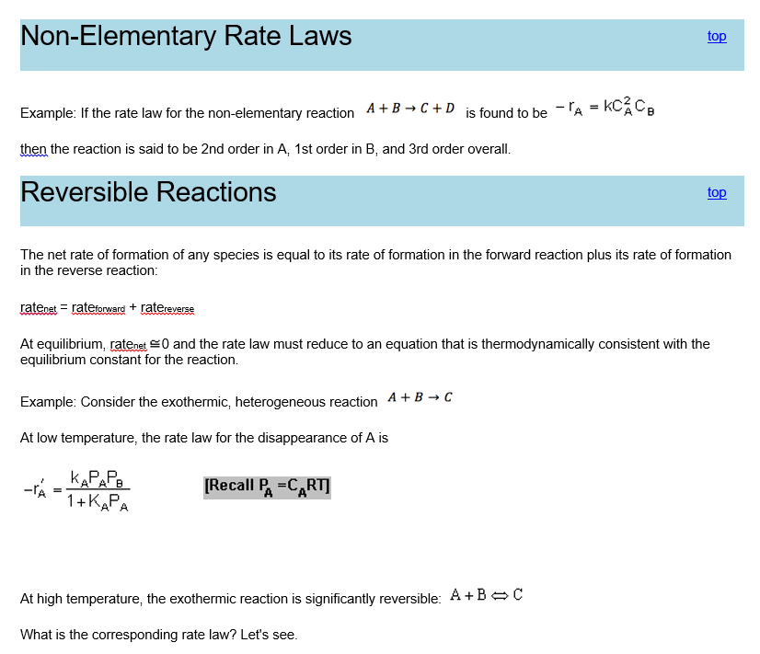
Fundamentals of CRE
Salah N. Farhan College of Engineering Diyala University

Slide 6
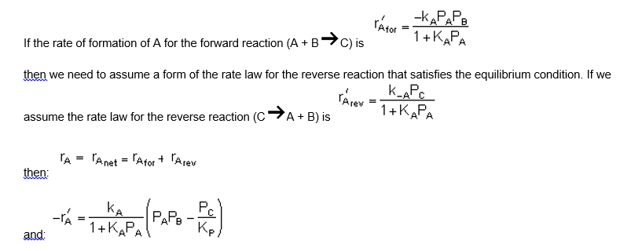
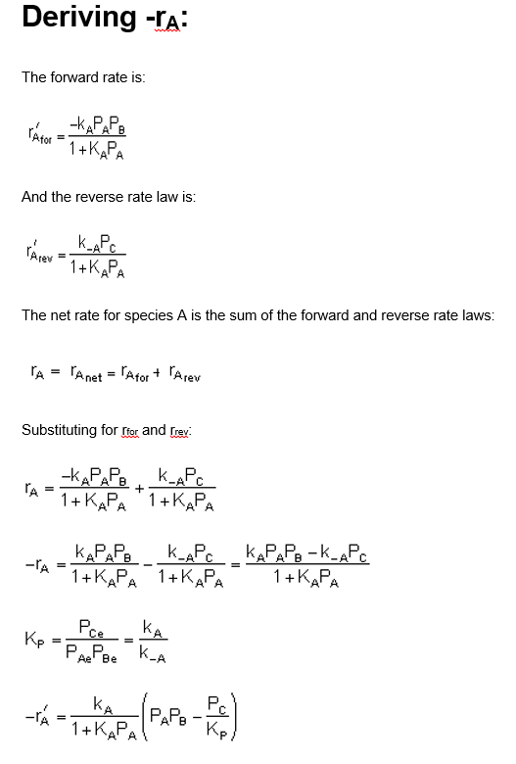
Fundamentals of CRE
Salah N. Farhan College of Engineering Diyala University

Slide 7
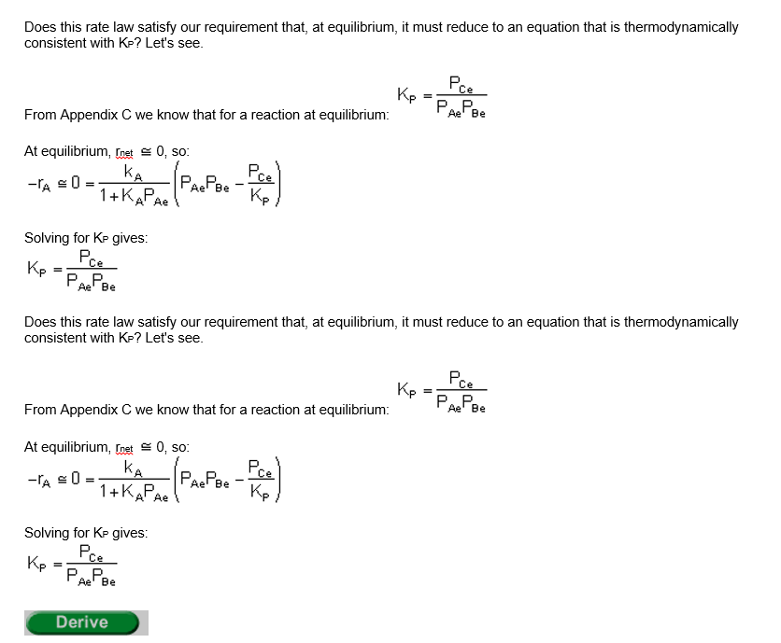
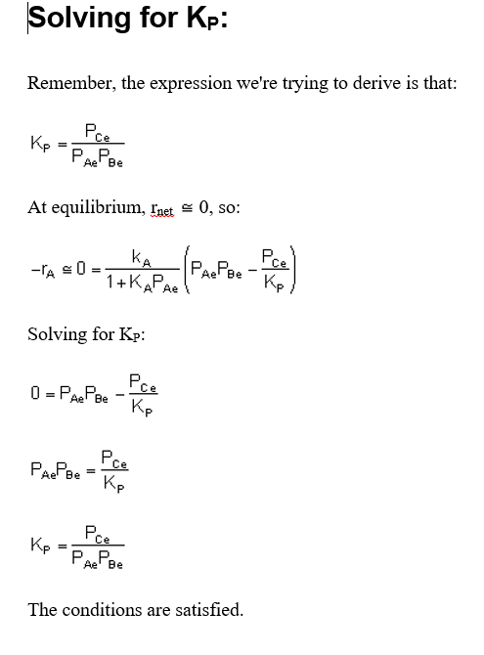
Fundamentals of CRE
Salah N. Farhan College of Engineering Diyala University

Slide 8
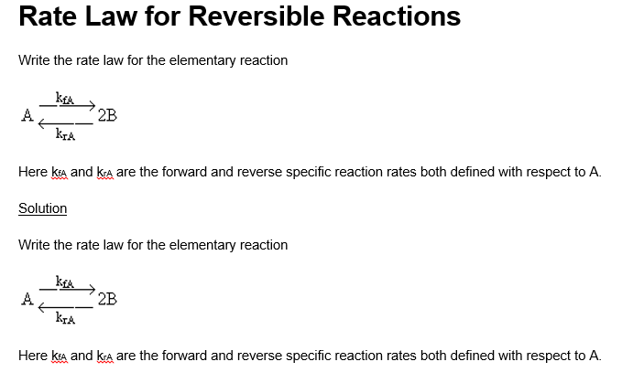
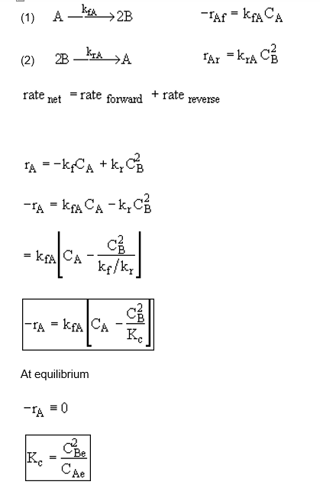
Fundamentals of CRE
Salah N. Farhan College of Engineering Diyala University

Slide 9
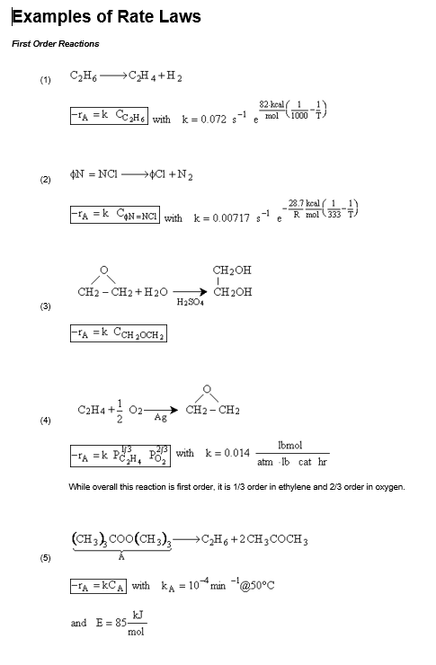
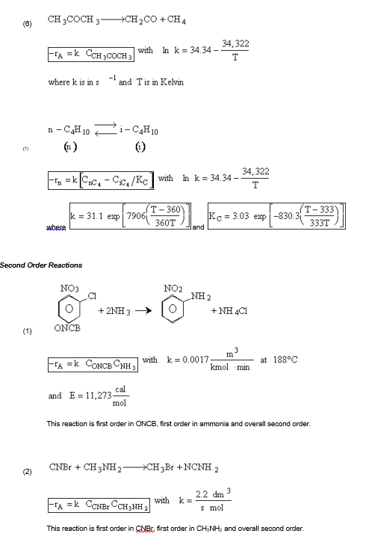
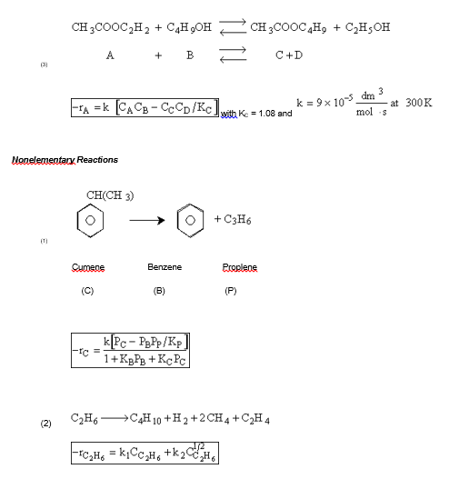
Fundamentals of CRE
Salah N. Farhan College of Engineering Diyala University

Slide 10
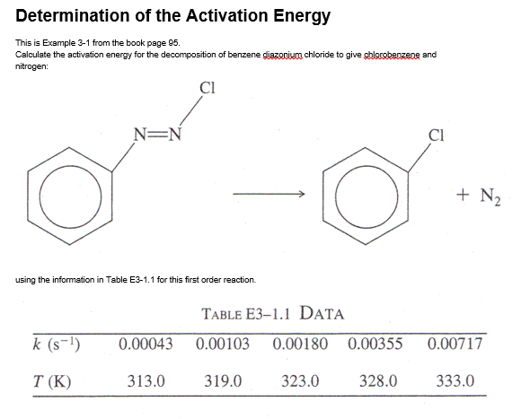
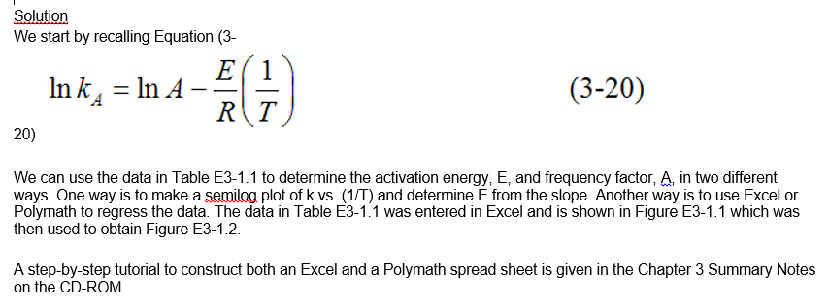
Fundamentals of CRE
Salah N. Farhan College of Engineering Diyala University

Slide 11
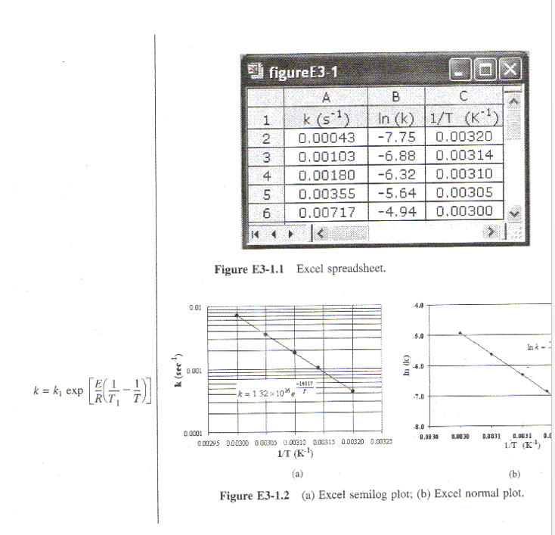
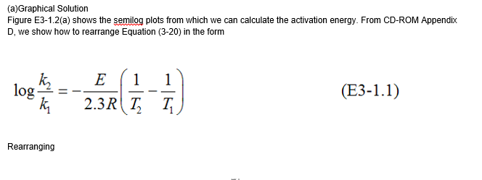
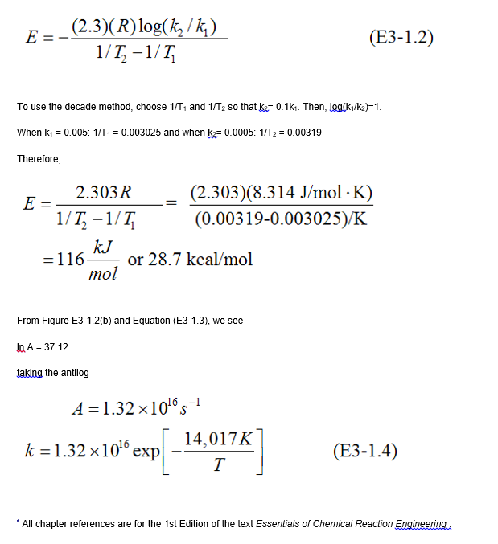
Fundamentals of CRE
Salah N. Farhan College of Engineering Diyala University

Slide 12
Fundamentals of CRE
Salah N. Farhan College of Engineering Diyala University

Slide 13
Fundamentals of CRE
Salah N. Farhan College of Engineering Diyala University

Slide 14
Fundamentals of CRE
Salah N. Farhan College of Engineering Diyala University

Slide 15
Fundamentals of CRE
Salah N. Farhan College of Engineering Diyala University

Slide 16
Fundamentals of CRE
Salah N. Farhan College of Engineering Diyala University

Slide 17
Fundamentals of CRE
Salah N. Farhan College of Engineering Diyala University

Slide 18
Fundamentals of CRE
Salah N. Farhan College of Engineering Diyala University

